Slide 1
Game Theory
Game Theory analyses the possible strategies in two person ‘games’, where each player has a number of options, each with a potential reward or cost.
A’s worst potential loss:
Eg
 | B plays 1 | B plays 2 | B plays 3
A plays 1 | (3,-3) | (-4,4) | (2,-2)
A plays 2 | (-1,1) | (4,-4) | (-2,2)
A plays 3 | (-3,3) | (1,-1) | (4,-4)
A plays 4 | (1,-1) | (-1,1) | (1,-1)
4
Eg If A plays 1 and B plays 2,
A loses 4
2
3
1
B’s worst potential loss:
3
4
4
A zero sum game is when the gain to one player is equal to the loss of the other
The play safe strategy is to choose the option with the smallest potential loss
A’s play safe strategy is to play 4
B’s play safe strategy is to play 1

Slide 2
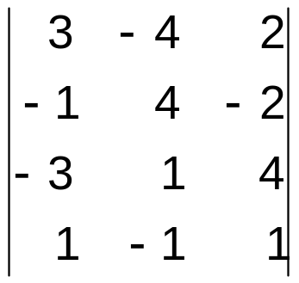
In a zero sum game, the possible outcomes are best shown in a pay-off matrix, where the value in cell IJ represent A’s winnings when A plays I and B plays J
Row minimum
 | B plays 1 | B plays 2 | B plays 3
A plays 1 | (3,-3) | (-4,4) | (2,-2)
A plays 2 | (-1,1) | (4,-4) | (-2,2)
A plays 3 | (-3,3) | (1,-1) | (4,-4)
A plays 4 | (1,-1) | (-1,1) | (1,-1)
-4
How often should A play 1,2,3 or 4? How often should B play 1,2 or 3? What they can they expect the value of the game to be?
-2
Eg
becomes
-3
-1
Column maximum
3
4
4
With the matrix set up from A’s perspective, the play safe strategies are found by:
The row maximin for player A
The column minimax for player B
If row maximin = column minimax the game is said to have a stable solution, meaning neither player has an incentive to vary from their play safe strategy. The game is said to have a saddle point at IJ if this happens.
If row maximin = column minimax, this tells you the players should play a mixed strategy. Identifying these strategies is the central method in D2 Game Theory.

Slide 3
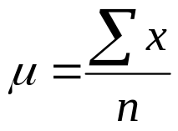

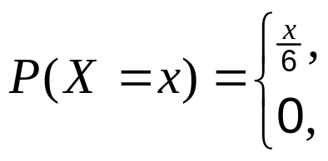







Expectation of a DRV
In GCSE you used this rule for the mean of a data set:
When dealing with discrete random variables, the equivalent to mean is Expectation E(X). In S1 you used the following rule:
Eg
otherwise
x | 1 | 2 | 3
P(X=x)

Slide 4
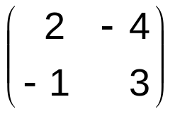










Calculating the value of a game
B plays 1
B plays 2
Eg suppose you have the following pay-off matrix
A plays 1
A plays 2
A has two choices, playing 1 or 2
If A plays 1 with probability p then they must play 2 with probability (1-p)
Then if B plays 1, A’s expected winnings are found by
But if B plays 2, A’s expected winnings are found by
Hence either or , depending on the strategy B adopts
Suppose A knows B will always play 1
Then A’s winnings will be a function of p
Eg if A always plays 1:
Eg if A always plays 2:
Of course, A does not know what strategy B will play so we can only go on to identify the value of p that represents a play safe strategy for A…

Slide 5
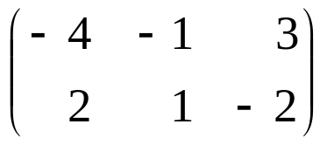








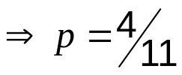

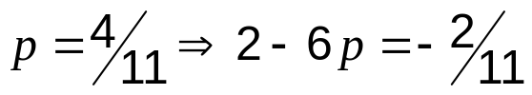

Row minimum
WB13 Emma and Freddie play a zero-sum game.
This game is represented by the following pay-off matrix for Emma.
-4
-2
a) Show that there is no stable solution.
Column maximum
2
1
3
b) Find the best strategy for Emma and the value of the game to her.
row maximin (-2) = column minimax (1)
Therefore no stable solution
Let Emma play R₁ with probability p
If Freddie plays:
C₁, Emma’s winnings are -4p + 2(1 - p) = 2 - 6p
4
4
3
3
C₂, Emma’s winnings are -p + 1(1 - p) = 1 – 2p
2
2
1
1
C₃, Emma’s winnings are 3p - 2(1 - p) = -2 + 5p
0
0
-1
-1
-2
-2
What does this tell us?
So Emma should play:
-3
-3
-4
-4
R₁ with probability
Eg if p=0 Emma always plays R₂ and she could lose as much as -2 if Freddie plays 1
R₂ with probability
The ‘play safe’ value of p is when the biggest potential loss is minimised
The value of the game to A is V(A), found by substituting the best value of p into either of the winnings equations that gave the required intersection
Hence the best p is identified by finding the lowest intersection on the diagram
The value of the game to Emma is

Slide 6

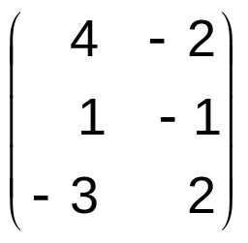
c) Write down the value of the game to Freddie and his pay-off matrix.
If the value of the game to Emma is
If the game is zero sum,
V(A) + V(B) = 0
Then the value of the game to Freddie is
The pay-off matrix for A was
To convert a pay-off matrix for A into a pay-off matrix for B, change the signs of every value and swap columns & rows
So the pay-off matrix for B is

Slide 7
WB14 A two person zero-sum game is represented by the following matrix for player A.
a) Identify the play safe strategies for each player.
Row minimum
 | B plays I | B plays II | B plays III
A plays I | 2 | -1 | 3
A plays II | 1 | 3 | 0
A plays III | 0 | 1 | -3
-1
0
-3
Column maximum
2
3
3
A’s play safe strategy is to play 2
B’s play safe strategy is to play 1
b) Verify that there is no stable solution to this game.
row maximin (0) = column minimax (2)
Therefore no stable solution

Slide 8
 | B plays I | B plays II | B plays III
A plays I | 2 | -1 | 3
A plays II | 1 | 3 | 0
A plays III | 0 | 1 | -3
c) Explain why the pay-off matrix above may be reduced to
 | B plays I | B plays II | B plays III
A plays I | 2 | -1 | 3
A plays II | 1 | 3 | 0
For A’s pay-off matrix, if all the values in row X are bigger than the corresponding values in row Y, row X is said to dominate row Y.
In which case, row Y can be deleted, as A would never choose this strategy.
For A, row II dominates row III, so A will never play 3 and it can be deleted

Slide 9






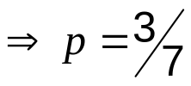

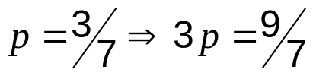

d) Find the best strategy for player A, and the value of the game.
 | B plays I | B plays II | B plays III
A plays I | 2 | -1 | 3
A plays II | 1 | 3 | 0
Let A play R₁ with probability p
If B plays:
C₁, A’s winnings are 2p + 1(1 - p) = 1 + p
4
4
3
3
C₂, A’s winnings are -p + 3(1 - p) = 3 – 4p
2
2
1
1
C₃, A’s winnings are 3p - 0(1 - p) = 3p
0
0
-1
-1
-2
-2
So A should play:
-3
-3
-4
-4
R₁ with probability
R₂ with probability
Never play R₃
The value of the game to A is
The value of the game to A is V(A), found by substituting the best value of p into either of the winnings equations that gave the required intersection
The best p is identified by finding the lowest intersection on the diagram

Slide 10








WB15 A two person zero-sum game is represented by the following matrix for player A.
 | B plays 1 | B plays 2 | B plays 3
A plays 1 | 5 | 7 | 2
A plays 2 | 3 | 8 | 4
A plays 3 | 6 | 4 | 9
a) Formulate the game as a linear programming problem for player A, writing the constraints as equalities and clearly defining your variables.
If p_{i} = the probability of A playing row i and V = the value of the game to A
Maximise P = V
As inequalities
Subject to:
As equalities
If B plays 1 then
If B plays 2 then
V is at most equal to one of these expectations
If B plays 3 then
Then the aim is to maximise V
The total probability is at most 1
Non-negativity!

Slide 11

b) Explain why it is necessary to use the simplex algorithm to solve this game theory problem.
The game is a three variable problem (p₁, p₂, p₃) and not reducible
c) Write down an initial simplex tableau making your variables clear.
b.v. | V | p₁ | p₂ | p₃ | r | s | t | u | value
r
1
-5
-3
-6
1
0
0
0
0
s
1
-7
-8
-4
0
1
0
0
0
t
1
-2
-4
-9
0
0
1
0
0
u
0
1
1
1
0
0
0
1
1
P
-1
0
0
0
0
0
0
0
0

Slide 12































d) Complete two complete iterations of the simplex algorithm,
indicating your pivots and stating the row operations that you use.
b.v. | V | p₁ | p₂ | p₃ | r | s | t | u | Value | θ
r
s
t
u
P
If the lowest θ values appear in several rows, just pick the first one
b.v. | V | p₁ | p₂ | p₃ | r | s | t | u | Value | Row ops
P

Slide 13




















b.v. | V | p₁ | p₂ | p₃ | r | s | t | u | Value | θ
V
s
t
u
P
As row 1 has already been used, pick row 2
b.v. | V | p₁ | p₂ | p₃ | r | s | t | u | Value | Row ops
P

Slide 14
More likely is that the pay-off matrix will have negative values in it
Eg
 | B plays 1 | B plays 2 | B plays 3
A plays 1 | -2 | 4 | 2
A plays 2 | 0 | -3 | -2
A plays 3 | -6 | 1 | 3
If this is the case, Simplex will only work if you first transform the game by making all values positive
Add 7 to all values
 | B plays 1 | B plays 2 | B plays 3
A plays 1 | 5 | 11 | 9
A plays 2 | 7 | 4 | 5
A plays 3 | 1 | 8 | 10
Let v = the value of the original game to A
Then V = v + 7 is the value of the transformed game to A
And the aim is still to maximise V

